Slide 1
Capstone Project
Analysing and Clustering
Neighbourhoods and Venues
For
New York City
&
Toronto

Slide 2
Aim of the project:
To gain a better understanding of similarities and differences between the two cities
What are the neighborhoods that are suitable for each type of business, and
What types of businesses are not very desirable in each city.
This allows business people to take better and more effective decisions regarding where to open their businesses.

Slide 3
Data Acquisition and Cleaning:
Neighbourhood Data Sets:
New York City = “https://cf-courses-data.s3.us.cloud-object-storage.appdomain.cloud/IBMDeveloperSkillsNetwork-DS0701EN-SkillsNetwork/labs/newyork_data.json”
Toronto = “https://en.wikipedia.org/w/index.php?
title=List_of_postal_codes_of_Canada:_M&oldid=1011037969”
(Data supplied by IBM Applied Data Science Course)
Neighborhood Data: datasets that lists the names of the neighborhoods of NYC and Toronto and their latitude and longitude coordinates.
Venues data: data that describes the top 100 venues (restaurants, cafes, parks, museums, etc.) in each neighborhood of the two cities.
The data should list the venues of each neighborhood with their categories.
This data has been retrieved from Foursquare which is one of the world largest sources of location and venue data.
Foursquare API will be utilized to get and download the data.

Slide 4
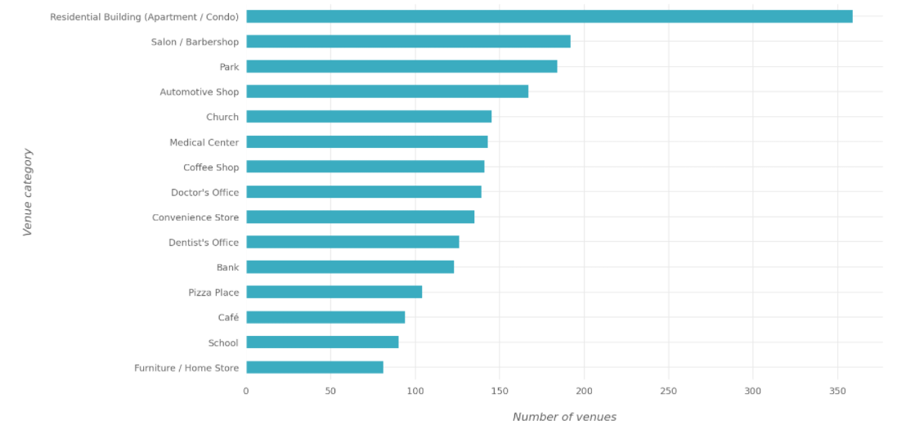
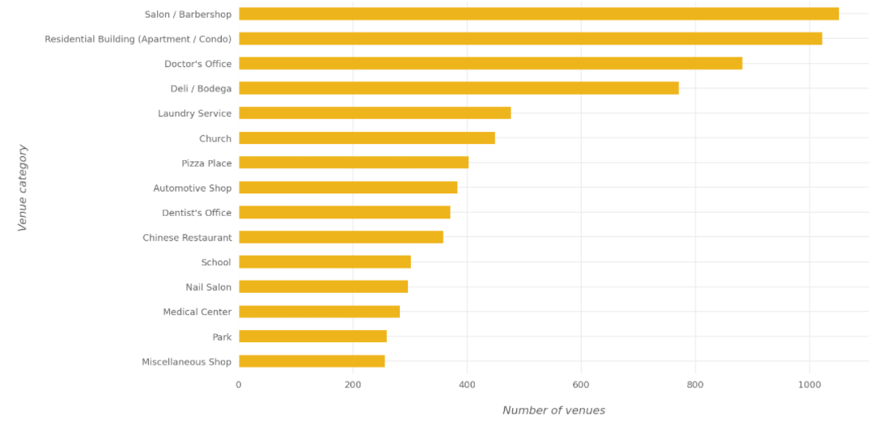
Most common categories in New York City
Most common categories in Toronto

Slide 5
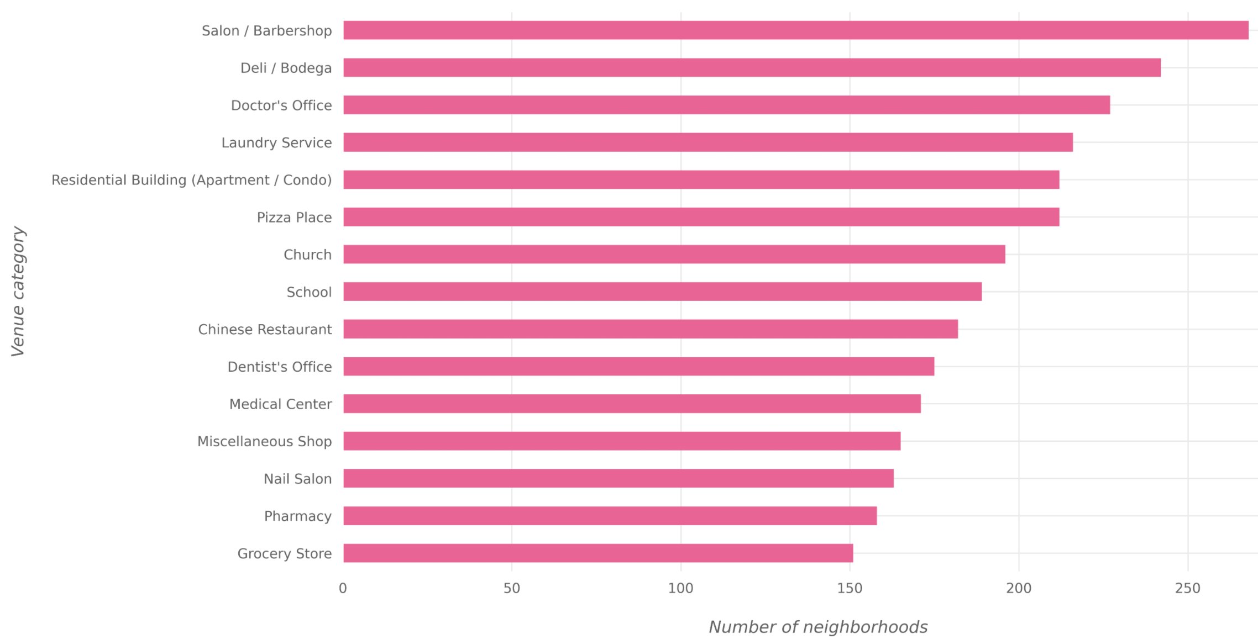
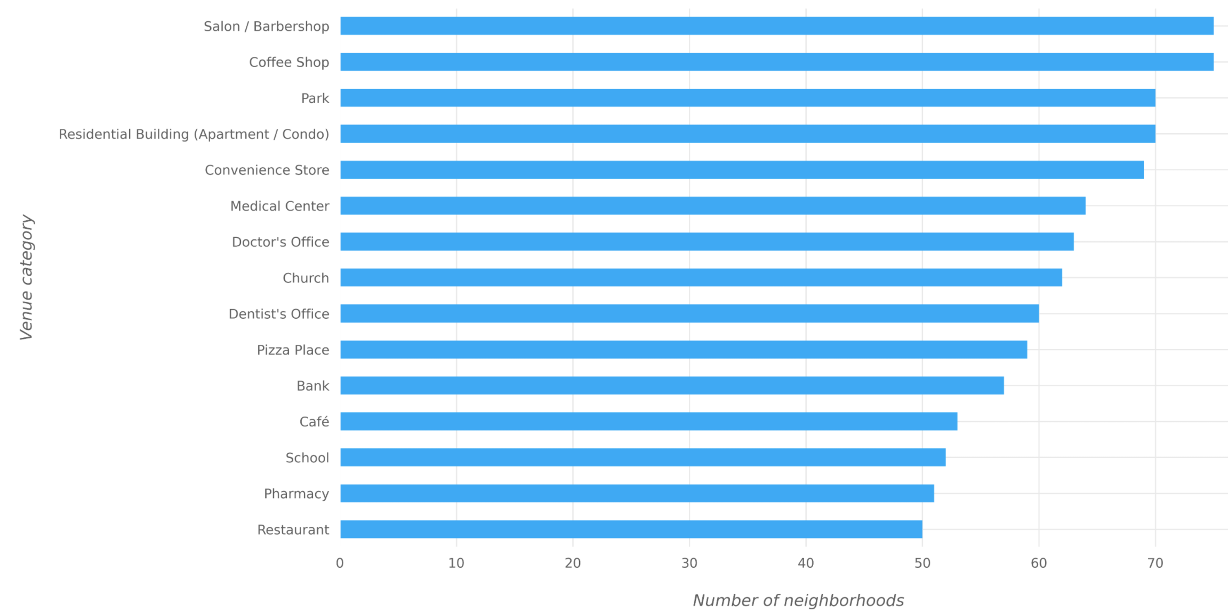
Most common venues in New York City
Most common venues in Toronto

Slide 6
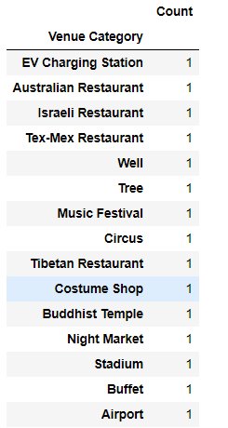
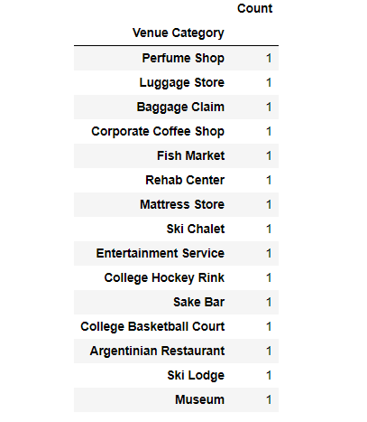
Rare categories in New York City
Rare categories in Toronto

Slide 7
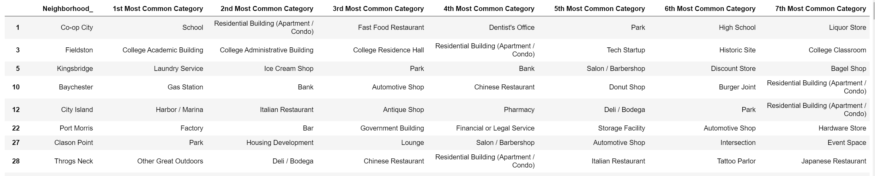
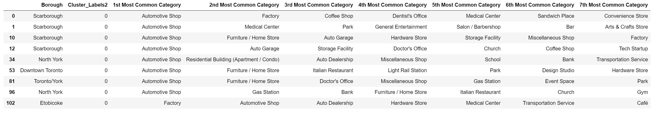
Results from Clustering New York City:
Results from Clustering Toronto:

Slide 8
Conclusion:
In this project, the neighborhoods of New York City and Toronto were clustered using K-Means clustering algorithm into multiple groups based
on the categories (types) of the venues in these neighborhoods.
The results showed that there are venue categories that are more common in some cluster than the others;
the most common venue categories differ from one cluster to the other.

